Slide 1
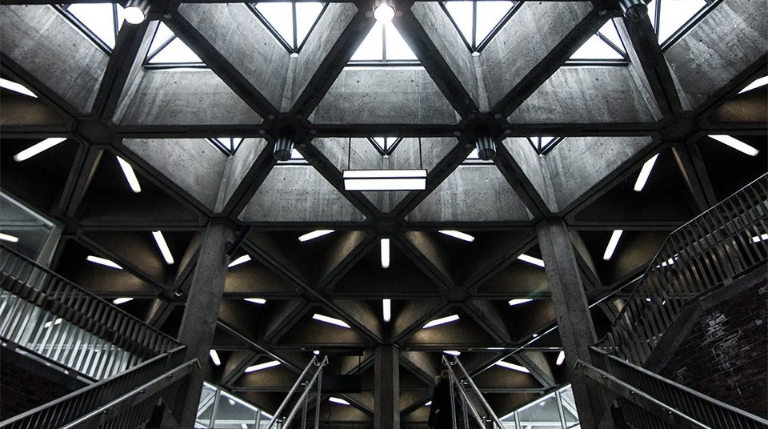
Capstone Project The Battle of Neighborhoods
Submitted By – Sankalp Chourasia

Slide 2
Introduction

Slide 3
Problem Statement
RecoWeb a recommendation website wants to offer a new type of feature that helps its users in categorizing the nearby eateries in major cities of the world with respect to uniqueness of cuisines and help tourists complete their tour without missing anything on the culinary side of things.
Stakeholders: RecoWeb
Target Audience: People touring these cities and looking
for unique cuisines.

Slide 4
Data

Slide 5
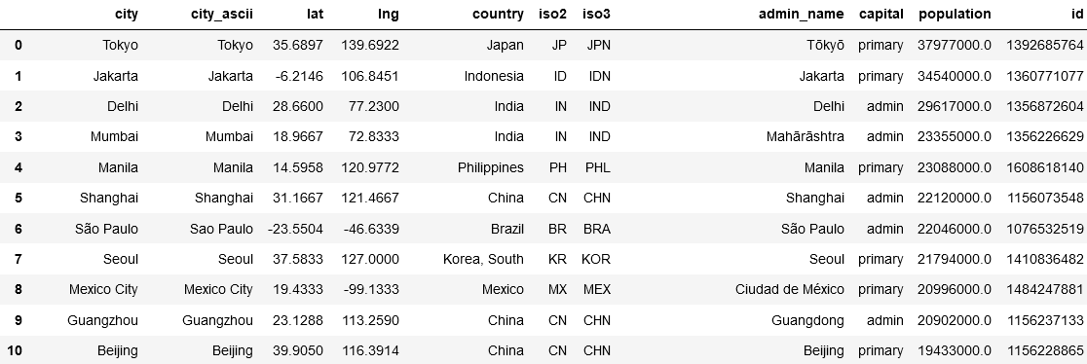
World Cities Dataset

Slide 6
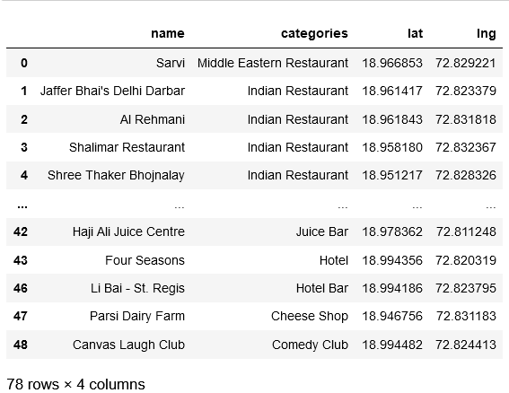
Foursquare API Query

Slide 7
Methodology

Slide 8
Methodology
1.Users will be asked to input a city of their choice.
2. We will first find out latitude and longitude for our city using a world cities dataset.
(Dataset attributed to : https://simplemaps.com/data/world-cities )
3. Then we will be using Four Square’s API to find out all eateries within a 5 km radius of
the city center.
The type of categories available are:
a. Food
b. Coffee
c. Drinks
4. We then clean our data to remove any duplicates that may have arisen due to overlap
of categories.

Slide 9
Methodology
5. We then one hot encode the data to make it suitable for simplified clustering.
6. We then use k means clustering to find similarities and dissimilarities between eateries.
7. Finally using Folium we display the results for each city.
8. In the end we output dataframes pertaining to various categories to educate user about all the different choices available to them in that particular city

Slide 10
Results

Slide 11
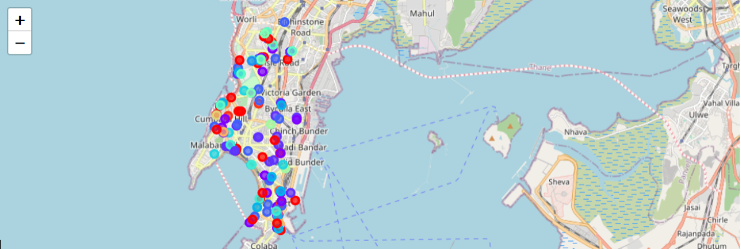
Results
Sample results for the city of Mumbai

Slide 12
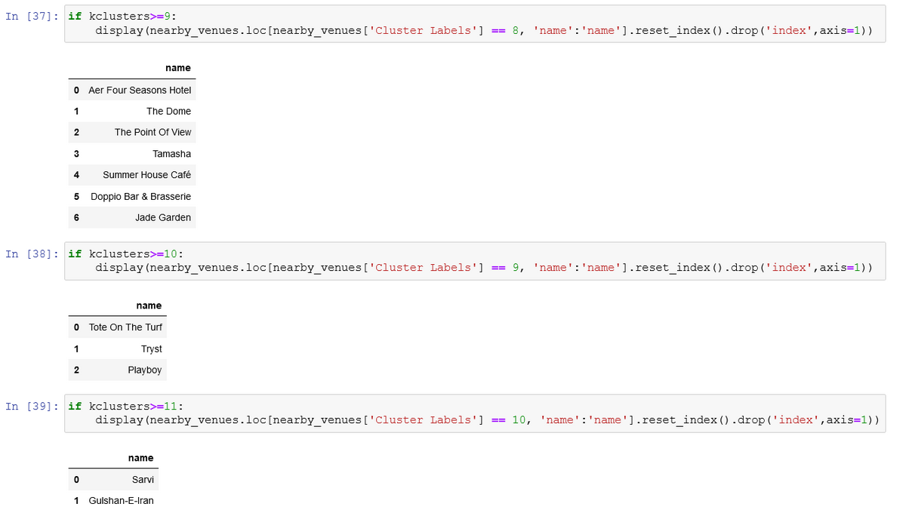
Results
Sample results for the city of Mumbai

Slide 13
Discussion

Slide 14
Discussion
We can make recommendations based on the above categories to our user and save them time and effort in looking into a huge list just to find a place to eat.
Additionally we can also further look out to include cities with same names but different locations or we can next use even more complex algorithms like DBSCAN to if we want to increase the complexity of the product.

Slide 15
Conclusion

Slide 16
Conclusion
The project concluded successfully in getting automated inference about the inquired city for its users and helped in categorizing the nearby eateries distinctively.

Slide 17
THANK YOU

